Slide 1





2 Thessalonians 3:5

Slide 2
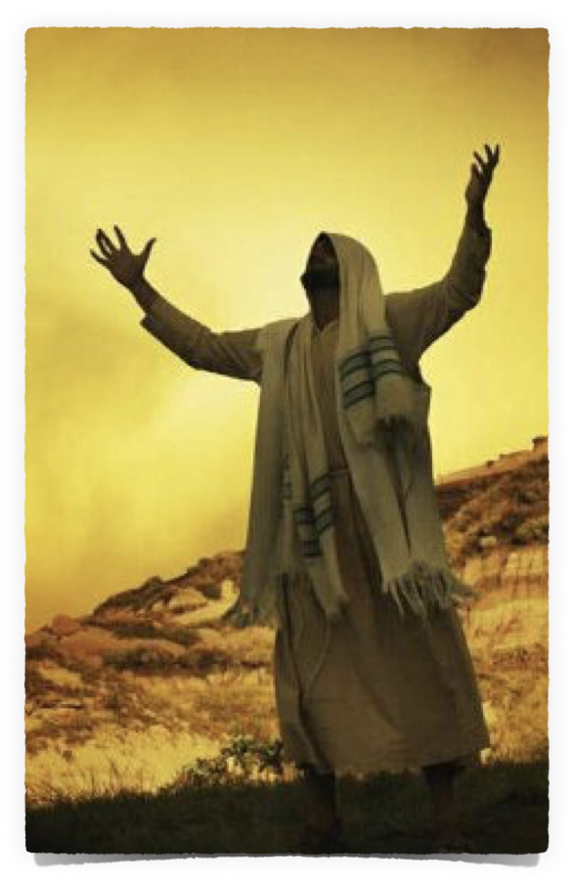
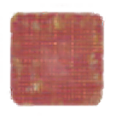
Patience is a recurring theme throughout the Bible and is a virtue many of us struggle with.
Patience stands as a countercultural invitation to trust in God’s way, promises, provisions, and timing.
Patience can be understood as the ability to endure difficult circumstances, the capacity to wait for God's timing, and the grace to bear with others’ weaknesses.
2 Thessalonians 3:5 (NKJV)
⁵ “Now may the Lord direct your hearts into the love of God and into the patience of Christ.”

Slide 3
We are being conformed into Christ’s character and teaching (Matthew 16:24–27; Philippians 2:5; Romans 8:28; 2 Corinthians 3:18).
As we focus on His example, we are enabled through faith to patiently endure trials, more consistently resist temptation, overcome obstacles, and successfully strengthen our brethren (cf. Hebrews 12:1,2; James 1:2-16; 1 Corinthians 10:13; 15:58).
2 Thessalonians 3:5 (NKJV)
⁵ “Now may the Lord direct your hearts into the love of God and into the patience of Christ.”

Slide 4

God is described as “merciful and gracious, slow to anger and abounding in steadfast love and faithfulness.” (Psalm 86:15; cf. Exodus 34:6, Joel 2:13).
Paul speaks about God's patience leading people to repentance (Romans 2:4)
God “is longsuffering toward us, not willing that any should perish but that all should come to repentance.” (2 Peter 3:9)

Slide 5
This divine patience sets the stage for understanding patience as a virtue for believers.
If God, who is perfect and just, exercises patience with imperfect humanity, how much more are His followers called to emulate this quality in their own lives? (Ephesians 5:1)

Slide 6

PATIENCE: A FRUIT OF THE SPIRIT
“But the fruit of the Spirit is love, joy, peace, long-suffering, kindness, goodness, faithfulness, ²³gentleness, self-control.” (Gal. 5:22,23)
The term “long-suffering” (makrothymia) is often translated “patient,” and suggests a patient attitude toward others, even in the face of provocation.

Slide 7
PATIENCE: A FRUIT OF THE SPIRIT
Such patience is not a common human trait but a characteristic cultivated by humbly “walking in the Spirit” (v. 16; cf. v. 18; Rom. 8:2,14; 1 Cor. 2:12-14; Eph. 3:3-5).
The Bible, being inspired by the Holy Spirit, instills within the believer a divinely authored, spiritual perspective (James 1:5-7; 3:15-18; Mat. 6:19-24; Hebrews 11:13-16; 12:2)

Slide 8
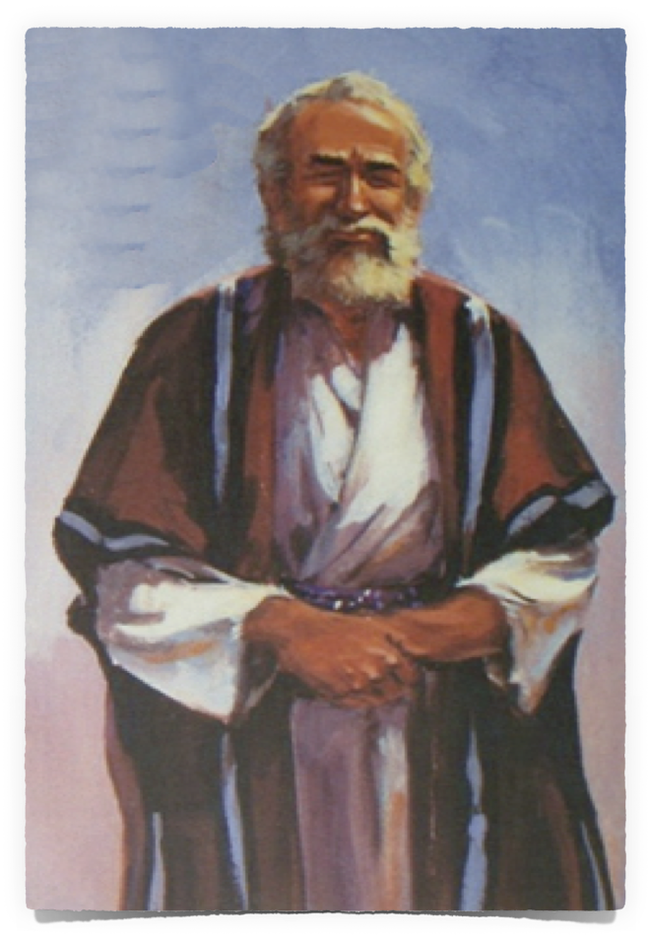
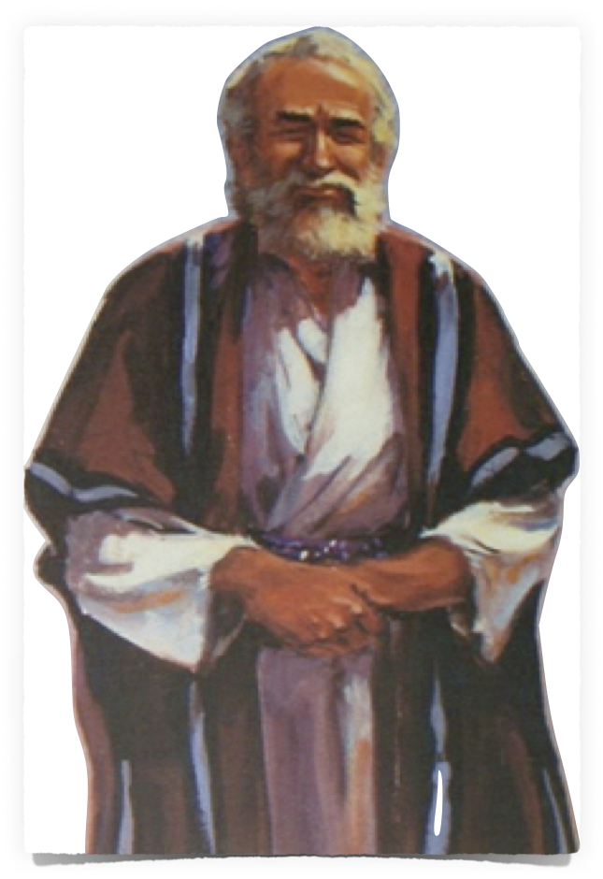
PATIENCE: FAITH TO ENDURE TRIALS
James 1:2–6 (NKJV)
² My brethren, count it all joy when you fall into various trials, ³ knowing that the testing of your faith produces patience. ⁴ But let patience have its perfect work, that you may be perfect and complete, lacking nothing. ⁵ If any of you lacks wisdom, let him ask of God, who gives to all liberally and without reproach, and it will be given to him. ⁶ But let him ask in faith, with no doubting, for he who doubts is like a wave of the sea driven and tossed by the wind.

Slide 9
PATIENCE: FAITH TO ENDURE TRIALS
Many Biblical heroes, illustrate the great reward of such patience, (James 5:10, 11a; Mat. 5:10,11; 10:22; Acts 7:52; Heb 11:1-12:2).
Job exemplifies this, as he endured immense suffering yet remained steadfast in his trust in God (Job 13:15).
James 5:11 (NKJV)
¹¹ Indeed we count them blessed who endure. You have heard of the perseverance of Job and seen the end intended by the Lord—that the Lord is very compassionate and merciful,”

Slide 10
PATIENCE: PERSEVERING IN HOPE
1 Thessalonians 1:3 (NKJV)
³ remembering without ceasing your work of faith, labor of love, and patience of hope in our Lord Jesus Christ in the sight of our God and Father,

Slide 11
PATIENCE: PERSEVERING IN HOPE
Patience reflects eschatological hope— ²⁵ But if we hope for what we do not see, we eagerly wait for it with perseverance. (Romans 8:25)
This forward-looking patience sustains believers through present struggles, anchoring them in the certainty of future glory (Rom. 5:3-5).

Slide 12
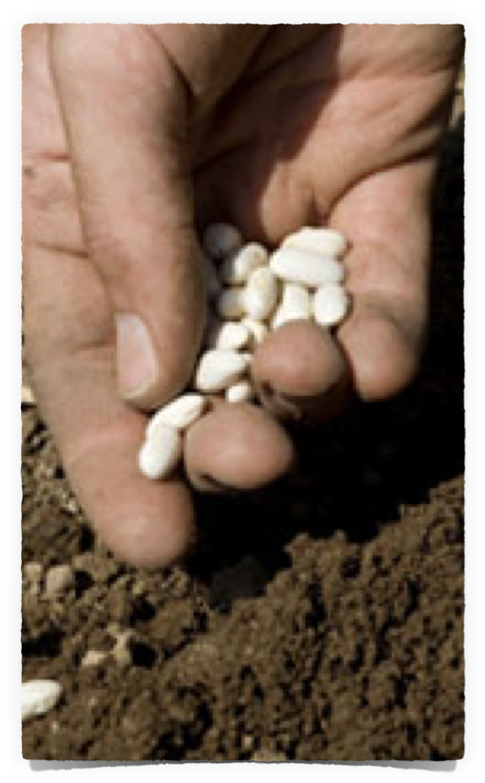
PATIENCE: PERSEVERING IN HOPE
So, patience involves actively waiting on God’s promises, rather than falling for Satan’s offer of immediate pseudo satisfaction, (2 Corinthians 4:16-5:5; 1 John 2:15-17; Psalm 27:14).
This hope stands upon our faith, (Hebrews 11:1).
Luke 8:15 (NKJV)
¹⁵ But the ones that fell on the good ground are those who, having heard the word with a noble and good heart, keep it and bear fruit with patience.

Slide 13

PATIENCE: LOVE SUFFERS LONG
Christians are called to forbear with others’ flaws as God forbears with ours (Exodus 34:6)
Jesus modeled this in His interactions with His disciples, patiently teaching them despite their frequent misunderstandings (e.g., Mark 8:17-21; John 13:1-17).

Slide 14
PATIENCE: LOVE SUFFERS LONG
Ephesians 4:1–2 (NKJV)
¹ I, therefore, the prisoner of the Lord, beseech you to walk worthy of the calling with which you were called, ² with all lowliness and gentleness, with longsuffering, bearing with one another in love,

Slide 15
PATIENCE: LOVE SUFFERS LONG
Ephesians 4:2 (NKJV)
² with all lowliness and gentleness, with longsuffering, bearing with one another in love,
anechomai (ἀνέχομαι, 430) to endure patiently (Mounce)
a state of emotional calm in the face of provocation or misfortune and without complaint or irritation—‘patience.’ (Lou Nida)
ἀνέχομαιª; ἀνοχή, ῆς f: to be patient with, in the sense of enduring (Lou Nida)

Slide 16
PATIENCE: LOVE SUFFERS LONG
Colossians 3:12–14 (NKJV)
¹² Therefore, as the elect of God, holy and beloved, put on tender mercies, kindness, humility, meekness, longsuffering; ¹³ bearing with one another, and forgiving one another, if anyone has a complaint against another; even as Christ forgave you, so you also must do. ¹⁴ But above all these things put on love, which is the bond of perfection.

Slide 17
PATIENCE: LOVE SUFFERS LONG
1 Thessalonians 5:14–15 (NKJV)
¹⁴ Now we exhort you, brethren, warn those who are unruly, comfort the fainthearted, uphold the weak, be patient with all. ¹⁵ See that no one renders evil for evil to anyone, but always pursue what is good both for yourselves and for all.

Slide 18
PATIENCE: LOVE SUFFERS LONG
Patience is genuine love in action — “Love is patient” (1 Corinthians 13:4),
Patience is not merely passive endurance but an active, loving choice to prioritize others’ well-being over personal frustration or convenience.
Our patience should mirror God’s patient love for us.

Slide 20
DO I NEED MORE PATIENCE
Are we easily angered, even over insignificant things, and often lose control over our actions or tongues?
Do we say and do hurtful things, and are we quick to blame others?
Do we tend to fret and worry about things over which we have no control?

Slide 21
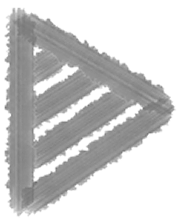
DO I NEED MORE PATIENCE
People who are impatient become members of the "throw away" generation, prematurely discarding relationships, people, jobs, education, churches, etc.,
    Are we generally pessimistic and fail to count our blessings?
Are we typically discontent / unhappy?
Do we tend to ignore the positive gains we and others have made, focusing on what has not yet been accomplished?

Slide 22
DO I NEED MORE PATIENCE
Do we become discouraged when our goals are not instantly realized?
Do we lose the ability to take a large goal and break it down into manageable increments?
Are we easily overwhelmed by the large tasks ahead of us and lose the hope and motivation to keep on trying?

Slide 23
HOW DO I GROW IN PATIENCE?
Most of us recognize the virtue of, and our need for patience.
Acquiring patience is NOT as simple and easy as microwave popcorn! — but it isn’t.
“God's way of answering the Christian's prayer for more patience, experience, hope and love often is to put him into the furnace of affliction.” Richard Cecil

Slide 24
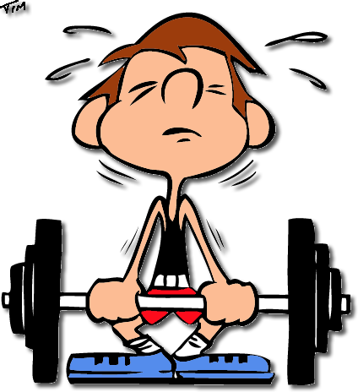

HOW DO I GROW IN PATIENCE?
Building strength in the physical body requires hard work, pain, time, and diligence.
Likewise, building spiritual fortitude, i.e., patience, also requires hard work, pain, time, and diligence (2 Peter 1:5-10).

Slide 25
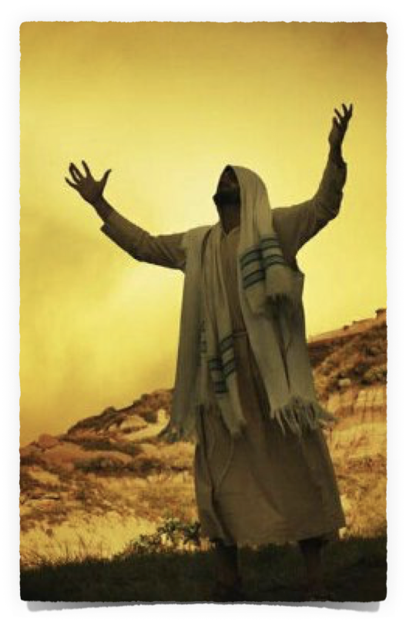
HOW DO I GROW IN PATIENCE?
To gain more patience, let us ask God (James 1:5,6) and do what is necessary to increase our faith.
As we increase our knowledge and understanding of God’s word, and we become more faithful, and consistent doers of God’s word, (Romans 10:17), our trust in God, as well as our dependence upon Him will be strengthened.

Slide 26
HOW DO I GROW IN PATIENCE?
Stronger faith engenders greater hope, and as we face and experience life’s challenges, hardships, and sorrows, our faith and hope enable us to, with patience, remain “steadfast, unmovable, always abounding in the world of the Lord” (1 Corinthians 15:58).

Slide 27
Patience is far more than passive waiting—it is an active, faith-filled endurance that reflects God’s character and advances His purposes.
Patience involves trust in God’s plan, steadfastness in trials, and a commitment to righteous living, even when the path is difficult.

Slide 28
For believers, it is a command and virtue that matures through trials and shines brightest in love.
“By your patience possess your souls. (Luke 21:19 - NKJV)

Slide 29
Hebrews 12:1–2 (NKJV)
¹ Therefore we also, since we are surrounded by so great a cloud of witnesses, let us lay aside every weight, and the sin which so easily ensnares us, and let us run with endurance the race that is set before us, ² looking unto Jesus, the author and finisher of our faith, who for the joy that was set before Him endured the cross, despising the shame, and has sat down at the right hand of the throne of God.

Slide 30
Romans 2:5–7 (NKJV)
⁵ But in accordance with your hardness and your impenitent heart you are treasuring up for yourself wrath in the day of wrath and revelation of the righteous judgment of God, ⁶ who “will render to each one according to his deeds”: ⁷ eternal life to those who by patient continuance in doing good seek for glory, honor, and immortality;

Slide 31
³⁵ Therefore do not cast away your confidence, which has great reward. ³⁶ For you have need of endurance, so that after you have done the will of God, you may receive the promise
Hebrews 10:35,36

Slide 33
Charts by Don McClain
Preached March 26, 2017 West 65th Street church of Christ
Preached March 23, 2025 Bryant church of Christ
501-568-1062
Prepared using Keynote / Email – donmcclain@sbcglobal.net / More Keynote, PPT & Audio Sermons:/ http://w65stchurchofchrist.org/coc/sermons/
2 Thessalonians 3:5

Slide 34
2 Thessalonians 3:1–5 (NKJV)
¹ Finally, brethren, pray for us, that the word of the Lord may run swiftly and be glorified, just as it is with you, ² and that we may be delivered from unreasonable and wicked men; for not all have faith. ³ But the Lord is faithful, who will establish you and guard you from the evil one. ⁴ And we have confidence in the Lord concerning you, both that you do and will do the things we command you. ⁵ Now may the Lord direct your hearts into the love of God and into the patience of Christ.

